Slide 1
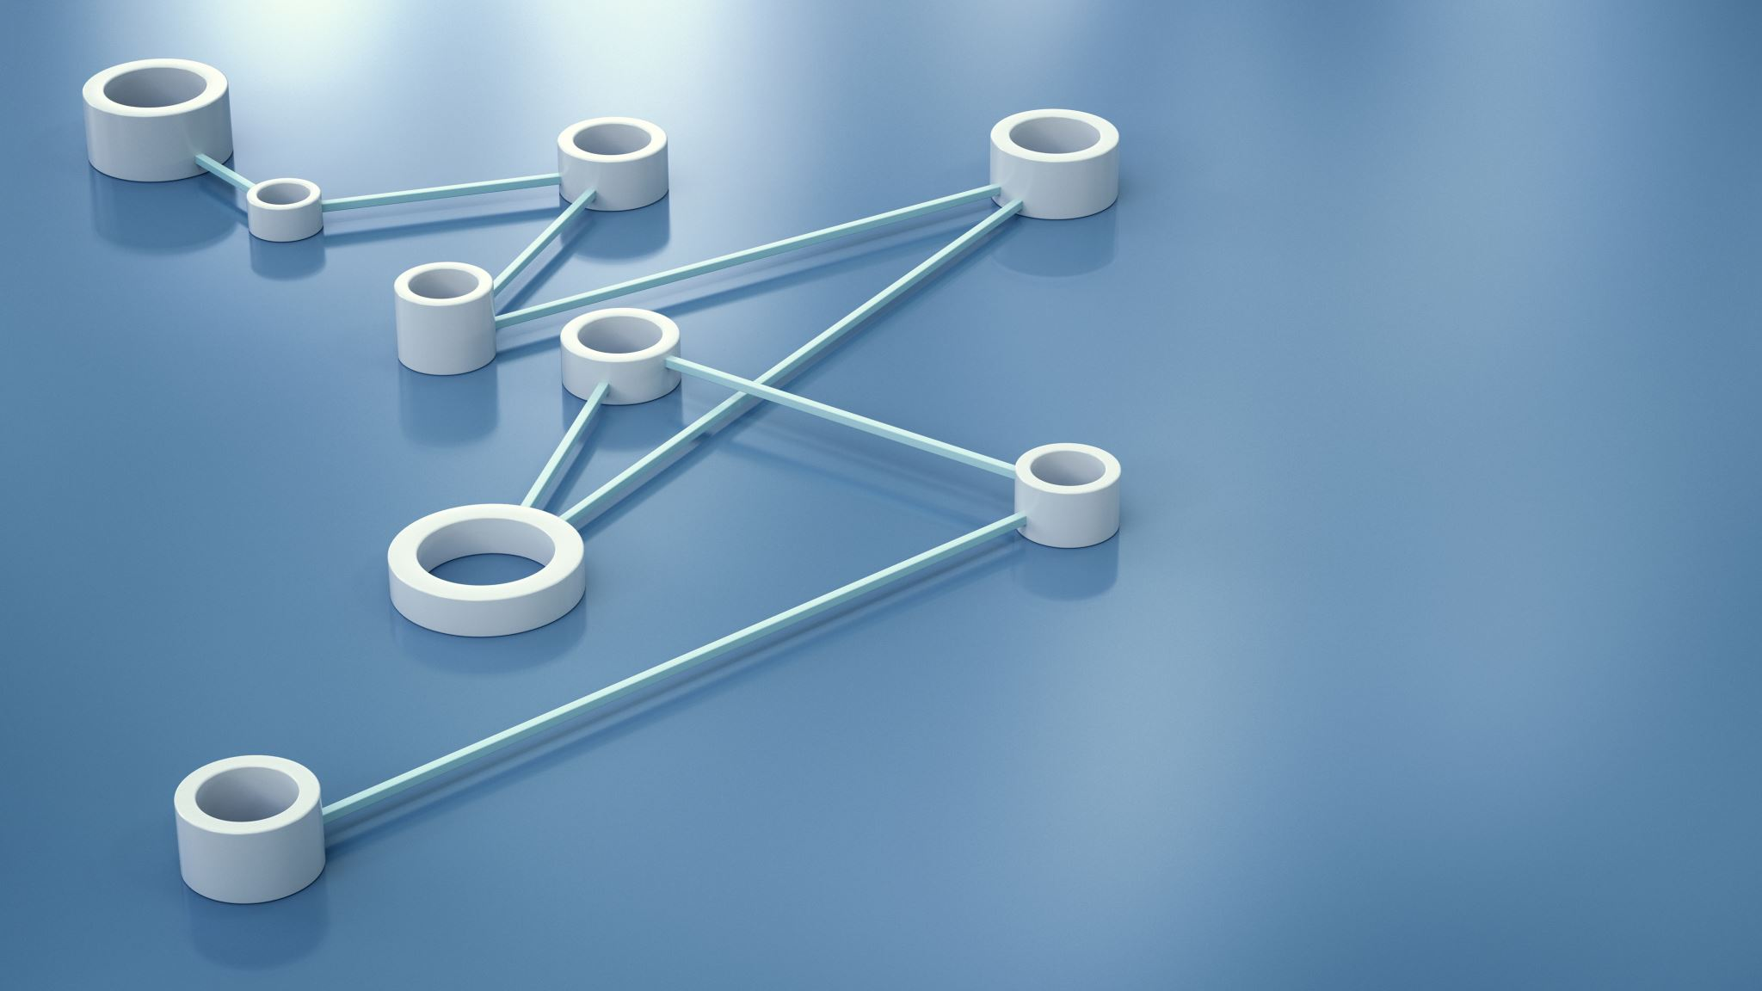
ORGANISATIONAL CONTROL :
THE SYSTEM AND PROCESS OF CONTROLLING

Slide 2
Abrar Shaikh – M2024005
Mohamed Adnan Shaikh – M2024007
Aman Saiyed– M2024016
Azeem Siddiqui – M2024028
Gaurav Patil – M2024037
Kain Fernando – M2024048
GROUP MEMBERS:

Slide 3

FLOW OF PRESENTATION
Introduction
The Basic Control Process
Benchmarking
Standards
Business Analytics
Critical Control Points
Control as a Feedback System
Real-time Information and Control
Examples
Case Study
Conclusion
Question & Answer

Slide 4
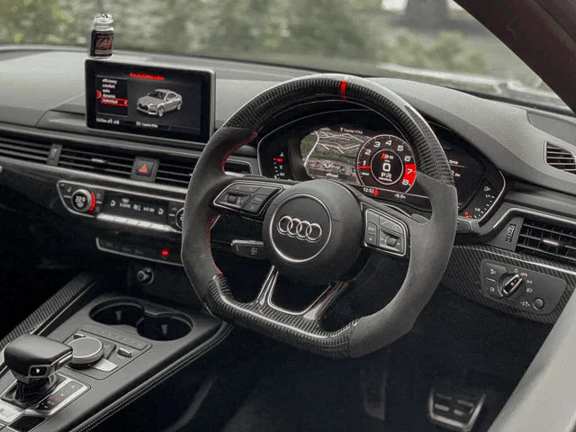
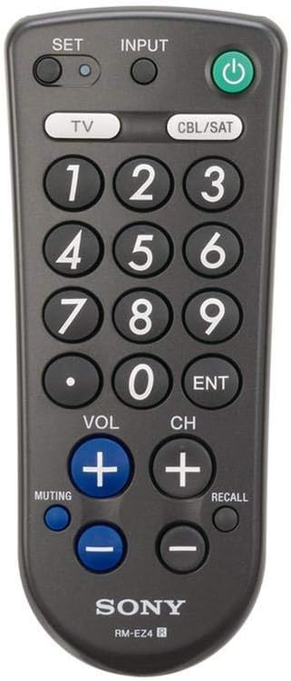
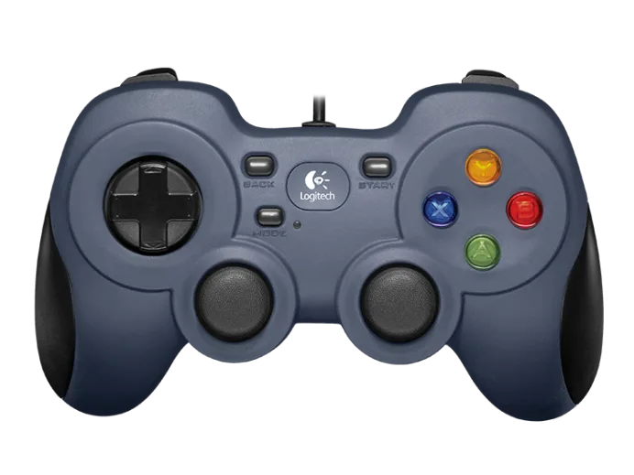
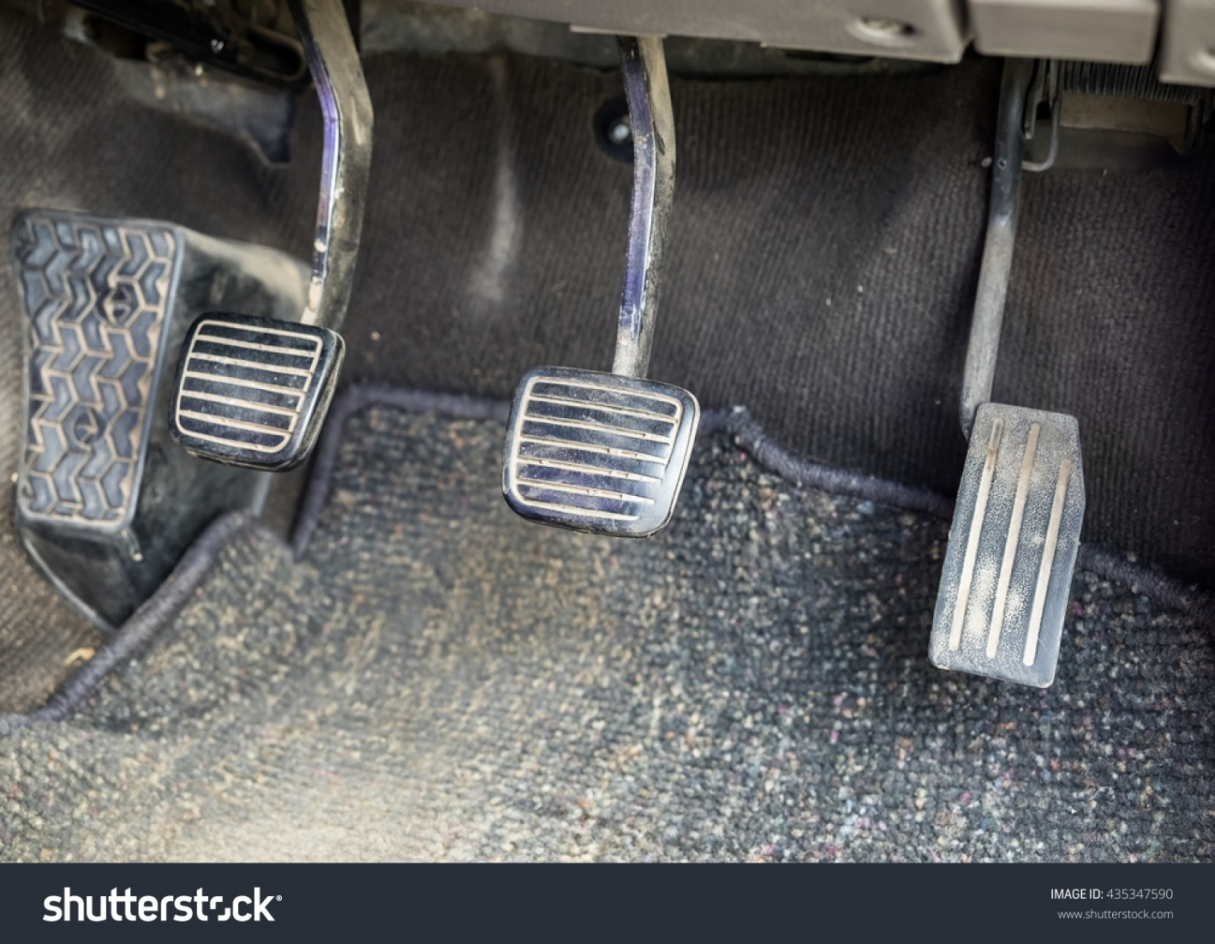
1.
2.
CAN YOU FIND ANY SIMILARITY IN ALL THESE PICTURES ?
3.
4.

Slide 5
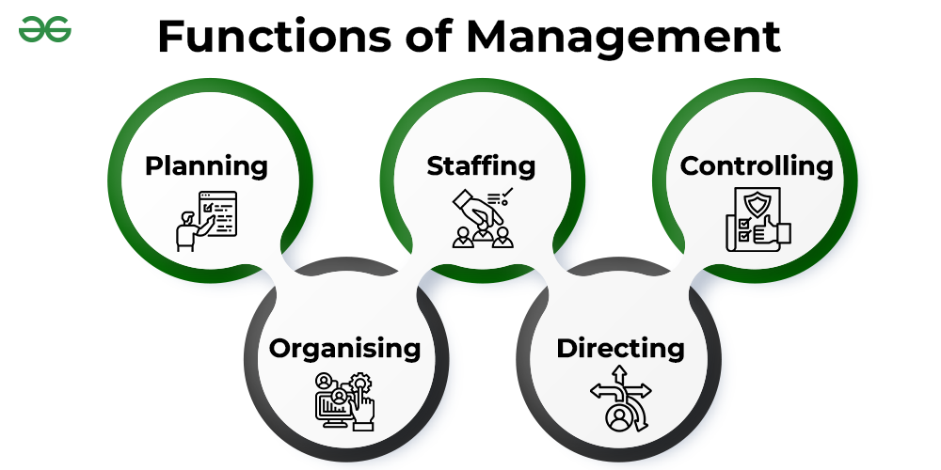

Slide 6
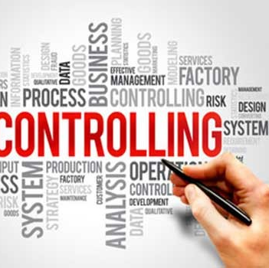
WHAT IS CONTROLLING?
Controlling is the process of monitoring performance and taking action to ensure desired results.
WHAT IS ORGANISATIONAL CONTROLLING?
“Controlling is the measurement and correction of performance to ensure that enterprise objectives and the plans devised to attain them are being accomplished.” – Koontz and O’Donnell

Slide 7
THE BASIC CONTROL PROCESS
Establishment of Standards
Measurement of Performance
Correction of Deviation

Slide 8
TYPES OF CONTROLLING
1. Feed-Forward Controlling
Feed-forward control is anticipating potential deviation and adjusting system input to prevent errors before they occur.
2. Concurrent Controlling
Concurrent control is monitoring and adjusting processes in real-time to ensure objectives are met.
3. Feedback Controlling
Feedback control is using feedback from a system to make adjustments and maintain desired performance.

Slide 9
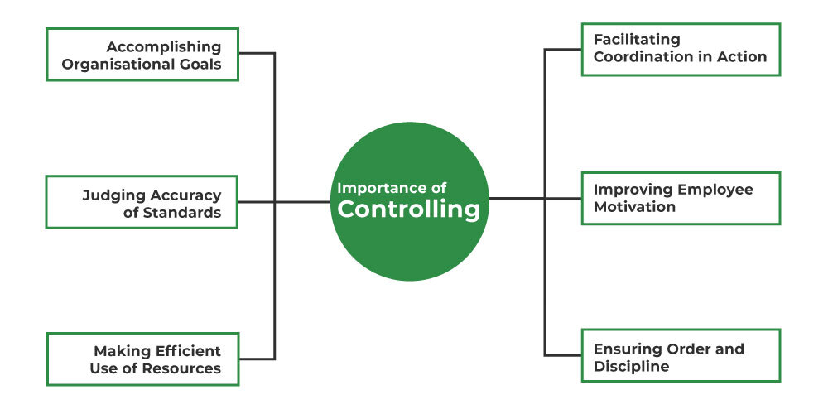

Slide 10

STANDARD AND BENCHMARKING
BENCHMARKING
What is Benchmarking?
Benchmarking is when a company compares its performance to the performance of other companies.

Slide 11
TYPES OF BENCHMARKING
Strategic Benchmarking
Strategic benchmarking is comparing your strategies and performance with the best in industry to identify improvement opportunities.
2. Operational Benchmarking
Operational benchmarking compares your internal processes with those of industry leaders to identify best practices and improve efficiency.
3. Management Benchmarking
Management benchmarking compares your management practices and processes with industry leaders to pinpoint areas for enhancement.

Slide 12
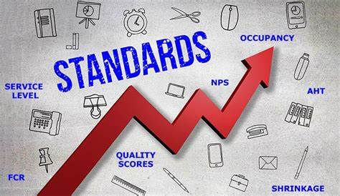
STANDARDS
What are Standards?
Standards are benchmarks or criteria used to measure performance.
Sets the Bars for success.
Standards helps in guiding performance and maintaining efficiency.

Slide 13
KINDS OF STANDARDS
Quantitative Standards
Qualitative Standards
Measurable aspect
Example: Financial target, production levels, etc.
Non-measurable aspect
Example: Customer satisfaction, product quality, etc.
These standards help managers evaluate performance and make necessary adjustment to achieve organisational goals.

Slide 14
CRITICAL CONTROL POINTS
Choosing points for special attention and then watching them to be sure that the whole operation is proceeding as planned
The principle of critical point control states that effective control requires attention to factors critical to evaluating performance against plans.
8.Strategic Plans
5.Program standards
6.Intangible standards
7.Goals as standards
Types of Critical Points Standard
1.Physical standards
3.Capital standards
4.Revenue standards
2.Cost standards

Slide 15
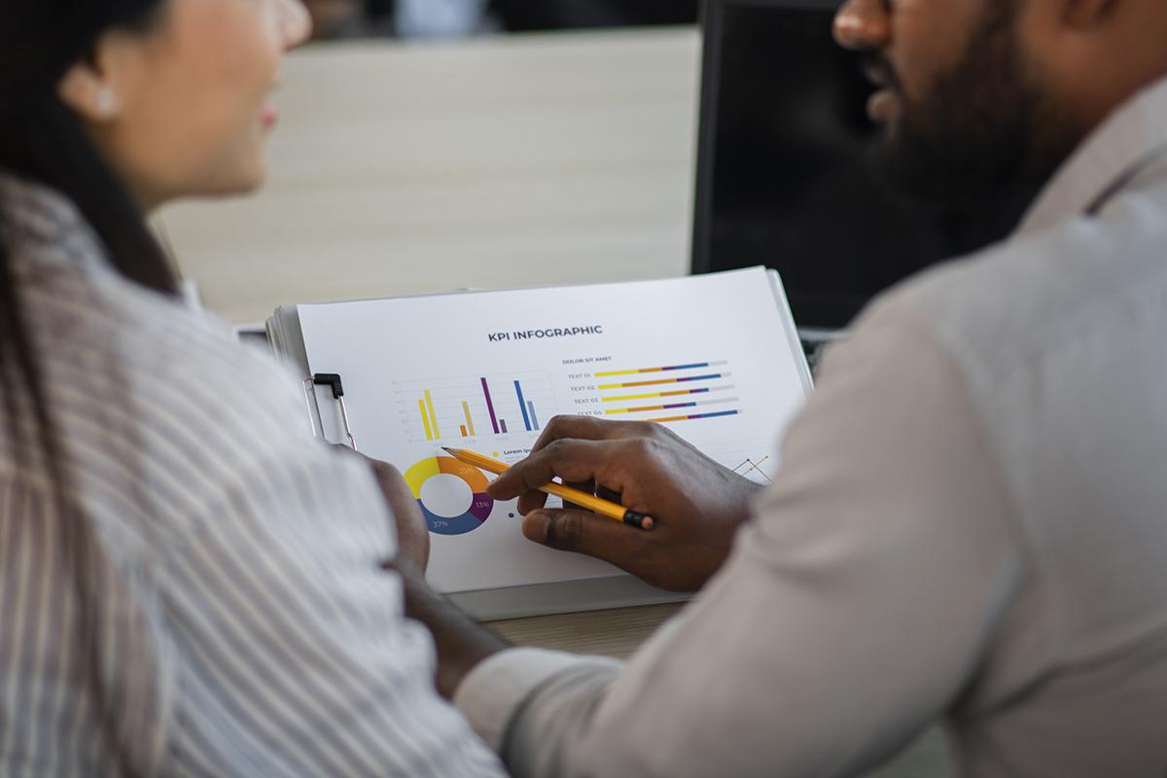
BUSINESS ANALYTICS
Business analytics refers to the statistical methods and computing technologies for processing, mining and visualizing data to uncover patterns, relationships and insights that enable better business decision-making.

Slide 16
Process of Data Analytics
Data Cleaning
Data Visualisation
Data Management
Data Analysis

Slide 17
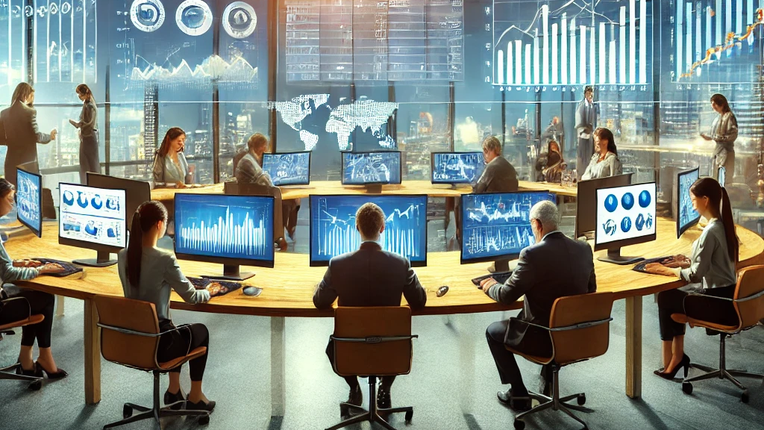
WHY BUSINESS ANALYTICS IN ORGANISATION CONTROL?
Wfejwofjwofkij
Felwkfwdlkfdl
Fdsfdf
Sfd
Sdf
Sdf
Sf
Sdf

Slide 18
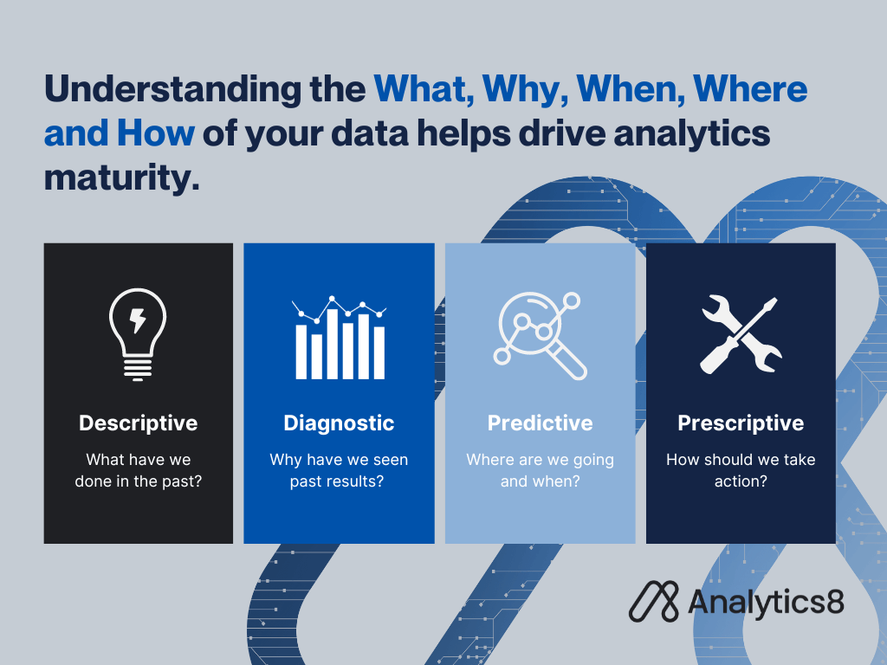
TYPES OF BUSINESS ANALYTICS

Slide 19
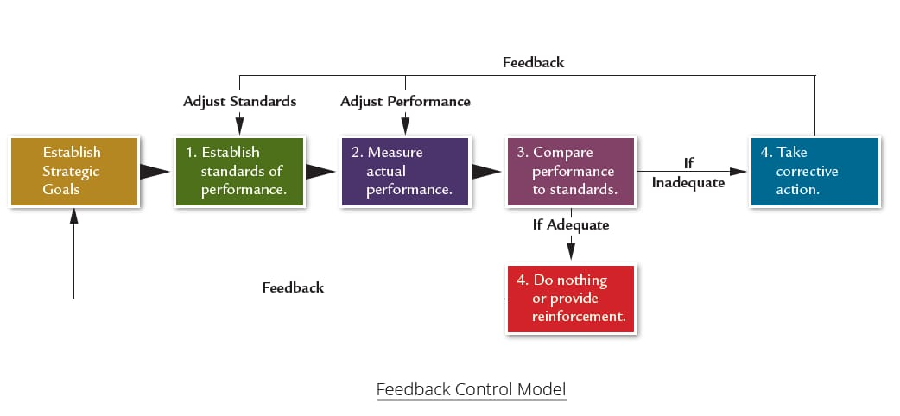
CONTROL AS A FEEDBACK SYSTEM
What is Feedback?
Feedback is information or responses given to an individual or group regarding their performance Behavior, or work.

Slide 20
Advantages
Important for continuous activity
Corrective course of action
Uses past performance for bringing future performance in line
Disadvantages
Lengthy process
Change in input can affect output
Input variables are considered as immeasurable

Slide 21

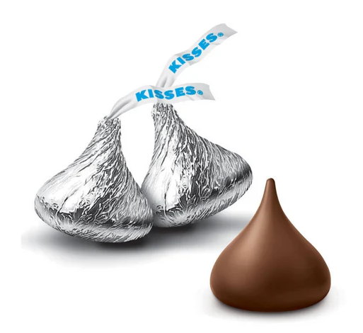

Hershey’s Kisses with sharp tip
Hershey’s Kisses with broken tip

Slide 22
REAL-TIME INFORMATION AND CONTROL
What is Real Time Information & Control?
Real-time information and control involve the continuous monitoring and management of systems, allowing for immediate access to data and quick decision-making.
Importance of Real-Time Information and control
Enhanced Monitoring
Improved Responsiveness
Timely Decision-Making
Real-Time Application
Airlines
Retailers
Manufacturers

Slide 23
CASE STUDY: REAL-TIME INFORMATION IN ACTION
Company Overview: XYZ Logistics, a global shipping and logistics provider, faced challenges in optimizing delivery routes and managing fleet performance.
Implementation:
Real-Time Tracking System
Data Analytics
Results:
Increased Efficiency
Cost Savings
Improved Customer Satisfaction

Slide 24



Examples of successful organisation control
Southwest Airlines organisational control
GE's organisational Control
Nestlé's organisational Control
Ensures Performance Standards
Identifies Deviations Early
Adapts to Changes
Maintains Competitiveness
Work-Out Performance Management System
Six Sigma Quality Management
Streamlined Operations
Innovation
Decentralized Structure
Focus on Compliance
Quality Assurance
Sustainability

Slide 25



Examples of unsuccessful organisation control
Accounting Fraud
Ineffective Internal Controls
Lack of Independent Oversight
Consequences
Accounting Scandal
Ineffective Internal Controls
Inadequate Oversight
Consequences
Accounting Fraud
Ineffective Internal Controls
Lack of Oversight
Consequences

Slide 26

Case study related to organisational controlling
Amazon's Performance Metrics System
Company Overview: Amazon is the largest e-commerce platform in the world. As of 2024, Amazon leads the global e-commerce sector with a market cap of $1.9 trillion. Amazon’s extensive product range, efficient logistics, and customer centric approach have made it a dominant force in the e-commerce market.
While Amazon was establishing its business back in 2019 amazon was facing certain severe problems such as:
Inconsistent Performance Tracking
Operational Inefficiencies
Customer Dissatisfaction
Data Utilization Issues, including many other inefficiencies.

Slide 27
Solution:
To address the challenges faced by Amazon before implementing the performance metrics system, Amazon introduced Performance Metrics System, that help amazon in the following ways:
Implement Regular Performance Reviews
Foster a Culture of Continuous Improvement
Enhance Communication and Transparency
Utilize Advanced Data Analysis
By implementing these solutions, Amazon was able to overcome its initial challenges, streamline operations, and achieve higher levels of efficiency and customer satisfaction.
Results After Implementation:
After implementing the performance metrics system, Amazon saw significant improvements:
Enhanced Performance Tracking
Operational Efficiency
Improved Customer Satisfaction
Data-Driven Insights

Slide 28
Effective control processes are essential for organisational success. By establishing clear standards, utilizing business analytics, recognizing critical control points, and applying benchmarking, organisations can ensure they are on track to meet their goals.
Control as a feedback system enhances this process, fostering a culture of continuous improvement and adaptability.
Encourage a culture of continuous improvement and adaptability to ensure alignment with goals.
CONCLUSION

Slide 29
Thank
You

